Slide 1
FY22 CAPITAL BUDGET SEMINAR
Construction/Renovation
www.nyc.gov/culture

Slide 2
HOW TO ASK QUESTIONS
We will address questions at the end of the presentation.
You can submit questions in the following ways:
      Q + A feature on Zoom
      Through emails to: capitalrequest@culture.nyc.gov
When you submit a question through any of the above options, please let us know your name and what organization you are with.
Please ensure your mics remain muted throughout the presentation and Q + A.

Slide 3


WHY WE ARE HERE
Overview the capital funding process:
  What makes a cultural organization’s capital project successful
  Funding constraints and time frames
Initiate the process:
  Meet fellow cultural organizations and learn about the City agencies (DCLA, DDC, EDC, DCAS, OMB) involved in the process
  Meet your DCLA project manager

Slide 4
CAPITAL PROJECTS: DCLA GOALS
Enhance the public’s experience of cultural life in New York City through projects that:
Increase public access to cultural programming throughout the City
Contribute to the vibrancy and diversity of the City’s communities and maximize the effectiveness of public/private partnerships
Preserve and promote the highest quality cultural facilities, programs and collections
YOUR ORGANIZATION CONTRIBUTES TO THESE GOALS
– THAT’S WHY YOUR PROJECTS HAVE BEEN FUNDED!

Slide 5
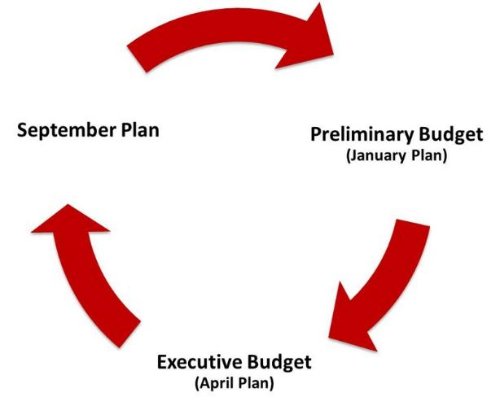
CITY BUDGET CYCLE
Each plan updates the City’s budget to reflect current project funding needs.
There are three major updates during the course of a fiscal year.
F Y 21
Expenditure Notification
F Y 22 Funding Request
Submissions
F Y 22 begins (July 1st)
Budget Adoption
Award letters

Slide 6
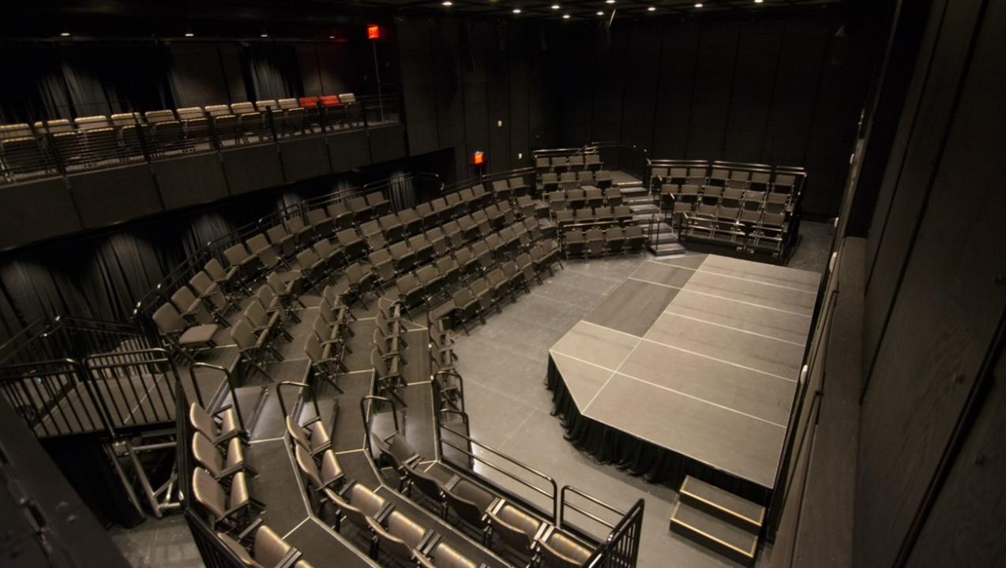
INITIAL REQUIREMENTS & EXPECTATIONS
  New Theater at Irish Arts Center
2

Slide 7

PUBLIC PURPOSE
Every project must further a public purpose, and the improved property or purchased equipment must be used consistently with the mission of the organization for the duration of the useful life of the improvement or equipment. Projects must establish a legal interest in the City funded asset by:
  enhancing City Owned Property or
  on non-City owned property, by legal agreements such as the following:
  Restrictive Covenant
When capital funds are being used for a capital improvement
  Security Agreement
  When capital funds are being used to purchase FF&E (e.g. computers, furniture, fixtures) (this is sometimes required on City owned property)
The specific legal agreements will be determined by the City and depend on your particular property and project.
The cultural organization must have site control for the duration of the capital improvement’s useful life (10-30 years), measured from the date of substantial completion.

Slide 8
FUNDING CONDITIONS
Its important to remember that these funds are not a grant. They are City funds allocated in the City budget and spent on behalf of your organization.
Organization agrees to:
  Follow the City’s process, adhere to Agency policy, comply with all requirements, and obtain approvals in order to successfully complete the project
  Initiate the project with DCLA and respond to City requests for information in a timely manner
Your funding allocation does NOT guarantee:
  Approval by government entities
  Disbursement of funding according to a pre-conceived timeline
  Disbursement of funding for a pre-conceived, unapproved scope of work or equipment purchase
  Disbursement of funding by a method that you prefer
YOUR ORGANIZATION MUST AGREE TO THESE
CONDITIONS TO RECEIVE CAPITAL FUNDING
NON-COMPLIANCE PUTS ALL CITY FUNDING AT RISK

Slide 9
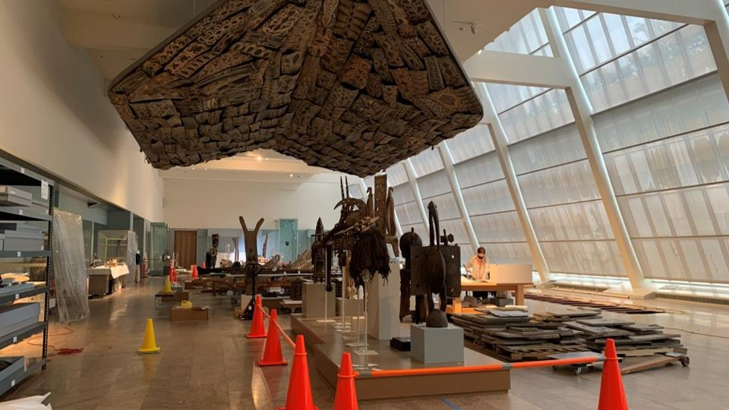
FULLY FUNDING THE PROJECT
Before the project starts, any gap between funds available and the project’s
total cost must be closed through other secure sources such as:
Board Donations
State and/or Federal Funds
Cash-in-hand
Other Non-City Funding
Metropolitan Museum Prepares for Renovation of AAOA Galleries

Slide 10
ORGANIZATION RESPONSIBILITIES
Get scope and design approvals for all city-funded capital projects
  DCLA approval at design phase milestones (Scope Development, Schematic Design, Design Development, Construction Documents)
  DCLA approval prior to submission to PDC or LPC
  Provide accurate information on operating implications (increased costs, maintenance, security, etc.)
Operational Responsibilities:
  Filings with DOB, FDNY, etc.
  Violations
  Maintenance Plan
  Certificate of Occupancy
  Public Assembly permits
  Compliance with local laws and City agency policies
DCLA approval of donor credit, naming rights, press announcements (including capital funding announcements) and signage

Slide 11
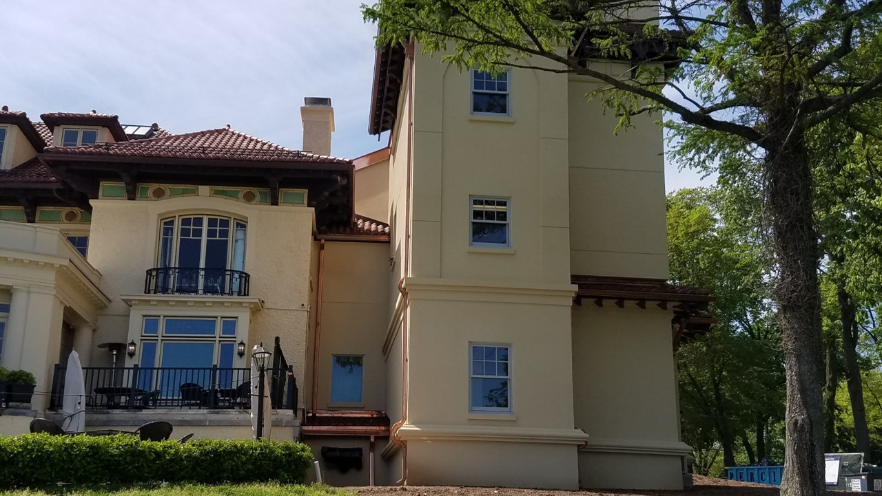
GETTING STARTED
  Casa Belvedere

Slide 12
(RE)DEFINE YOUR PROJECT
Since submitting your Capital funding request, things might have changed, e.g.
Your project was not fully funded
Design plans or your organization’s priorities changed
You received funding from a source other than the City
The actual project scope can be different from the project described in your funding request.
The project scope should realistically reflect the funding available in the active fiscal year. Discuss your project in detail with your DCLA Project Manager as soon as possible so that we can initiate the administrative review and approval process.
Documents you should prepare for DCLA’s review:
DCLA’s Program, itemized project budget, and operations budget (all projects)
Design documents and cost estimates (if applicable)
FA and CCGs: Scope narrative, application package, board resolution, and DCLA Program form

Slide 13
THE FOUR KEY REVIEW STAGES
1) DCLA
Scope Review & Approval
Establishes project eligibility and feasibility
2) DDC/EDC/DCLA/DCAS
Scope Review & Project Administration
Works with architects, engineers and the organization to manage the design and construction process
3) OMB
Project Review & Approval
Reviews the project for capital eligibility and issues necessary funding approvals
4) COMPTROLLER
Project Review & Approval
Reviews and authorizes capital projects for conformity with applicable accounting standards and directives

Slide 14
ELIGIBLE PROJECTS
Construction/Renovation
Equipment
Construction of new facility
Expansion of existing facility
Upgrade/renovation of contiguous existing space
Upgrade/replacement of building system e.g. HVAC
$500K minimum initial City contribution for non-City owned property
Equipment systems or standalone equipment (at least $50K)
$250K minimum for non-moveable equipment (e.g. seating system attached to the floor)
F Y 22 Equipment Workshop will be held on Tuesday, August 10.

Slide 15
CAPITAL ELIGIBILITY: DEFINITIONS
Comprehensive
Create new asset/systems
Upgrade existing asset
City Purpose
Provides public benefit for useful life of improvement or equipment
Long-Term Investment
Construction/renovation: 10-30 years
Minimum City Contribution
Construction/renovation: at least $500K (for non-City owned property)

Slide 16
DIRECTIVE 10
CHARGES TO THE CAPITAL PROJECTS FUND
In order to attain capital eligibility, a project must comply with the Comptroller’s Directive 10 and its definition of comprehensive betterment:
Directive 10 defines comprehensive betterment as extensive, physically connected, and typically involved in all four trades (electrical, plumbing, HVAC, and general construction)
It specifically does not allow work in non-contiguous spaces unless functionally related, i.e. dependent upon each other and necessary for the asset to perform its primary purpose
If a project does not meet this definition of comprehensive betterment, the cost of renovations to different areas of a building or element of infrastructure must each be at least $50,000 minimum
https://comptroller.nyc.gov/services/for-city-agencies/comptrollers-directives-and-memoranda/directives-and-memoranda/

Slide 17
INELIGIBLE CAPITAL COSTS
Maintenance:
Repair/Maintenance work, e.g. roof patching
Painting & carpeting as standalone scope
Extended warranties
Maintenance agreements & service contracts
Studies:
Environmental assessments (as a stand-alone item)
Feasibility studies
Fixtures/Equipment:
Fixtures or equipment that require attachment to the property are ineligible unless additional legal requirements are met
Organization-specific signage/donor plaques
Operational:
Employee salaries
Administrative expenses
Training
Other:
Fundraising, financing, owner’s rep, or legal fees
Work performed prior to the capital appropriation
Custom databases
Unique or excessively expensive

Slide 18
LOCAL LAWS AND CITY POLICIES 1
City-funded projects must meet certain Local Laws and City Policies.
Here are some that typically apply to cultural capital projects:
Green Building Laws
Green Building Laws and Regulations:
Local Laws 86 of 2005, 31 and 32 of 2016
Sustainable design intended primarily to reduce energy and water consumption
Largely applies to city-owned projects
Also applies to non-city-owned projects at 50% funding contribution or funding over $10,000,000
https://www1.nyc.gov/site/oec/green-building/green-building-laws-regulations.page
https://codelibrary.amlegal.com/codes/newyorkcity/latest/NYCcharter/0-0-0-1041
Local Law 92/94 of 2019:
Green Roofs
A Local Law to amend the New York City building code, in relation to requiring that the roofs of certain buildings be partially covered in green roof or solar photovoltaic electricity generating systems

Slide 19
LOCAL LAWS AND CITY POLICIES 2
City-funded projects must meet certain Local Laws and City Policies.
Here are some that typically apply to cultural capital projects:
Local Law 1: M/WBE
Ensures NYC certified minority and women owned business enterprises have greater access to public contracting opportunities.
https://www1.nyc.gov/site/mocs/partners/about-m-wbe.page
Local Law 51 of 2017:
Induction Loops
Requires that any capital project with an estimated baseline construction cost of $950,000 or more involving the construction of one or more “assembly areas” include the installation of an induction loop assistive listening system in at least one assembly area and “microlooping” each security, information or reception desk used for check-in.
For more information and exemptions visit: https://www1.nyc.gov/assets/mopd/downloads/pdf/laws_local-law_51.pdf

Slide 20
LOCAL LAWS AND CITY POLICIES 3
City-funded projects must meet certain Local Laws and City Policies.
Here are some that typically apply to cultural capital projects:
Local Law 58 of 1987:
Accessibility
Mandates that the design and construction of buildings accommodate the accessibility needs of people with disabilities, including appropriate routes of movement in the interior and exterior of the building, interior room modifications, and adjustment of facilities
https://www1.nyc.gov/assets/buildings/local_laws/ll58of1987.pdf
General Accessibility
Laws
Accessibility requirements regulated by NYC Building Code A117.1 (City law) and 2010 ADA Standards for Accessible Design (Federal law)
Path of travel: An alteration that affects or could affect the usability of or access to an area of a facility that contains a primary function shall be made so as to ensure that, to the maximum extent feasible, the path of travel to the altered area and the restrooms, telephones, and drinking fountains serving the altered area are readily accessible to and usable by individuals with disabilities, including individuals who use wheelchairs, unless the cost and scope of such alterations is disproportionate to the cost of the overall alteration.

Slide 21
Local Laws and City Policies 4
City-funded projects must meet certain Local Laws and City Policies.
Here are some that typically apply to cultural capital projects:
State/City Environmental
Review Act (SEQRA/CEQR)
Applies to city-owned property
Evaluates a project’s impact on the environment, e.g. purpose, appearance or condition of a structure or natural resource
www.dec.ny.gov and http://www1.nyc.gov/site/oec/environmental-quality-review/technical-manual.page
Interfund Agreement
Fees (IFA)
Applies to all capital projects. Does not apply to equipment purchases
An administrative fee that is deducted from your capital funding allocation
IFA ranges from 2-14%
Addressed in the NYC Comptroller’s Directive 10, Section 9.0

Slide 22
ADDITIONAL APPROVALS
Projects may be subject to additional approvals from the following agencies and commissions:
Landmarks Preservation
Commission (LPC)
Approval required for any alteration, reconstruction, demolition or new construction affecting landmarked property
Documents, drawings and other materials describing proposed work reviewed and approved before issuance of permit
Fees for LPC permits when work requires DoB permit
http://www.nyc.gov/html/lpc/html/home/home.shtml
Public Design
Commission (PDC)
Approval required for exterior work on or above City-owned property
Conceptual, preliminary and final designs are reviewed and approved
http://home2.nyc.gov/html/artcom/html/home/home.shtml
Department of
Buildings (DoB)
Reviews and approves plans and permits for construction and renovation projects
Fees for inspections and permits performed by the DoB
http://www.nyc.gov/html/dob/html/home/home.shtml
15

Slide 23
OFFICE OF MANAGEMENT AND BUDGET
The Office of Management and Budget (OMB) reviews all project documentation:
  Capitally eligible project scope
  Itemized project budget, funding status, and operating expense implications
  Legal Agreements
  City ownership -OR- If Non-City ownership, additional legal agreements (including Restrictive Covenant and/or Security Agreement)
Review time is estimated to be 90 days
Project must be fully funded before OMB will begin their review
If OMB approves the project, OMB will issue a Certificate to Proceed (CP)

Slide 24
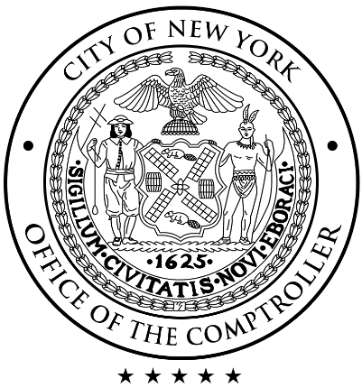
COMPTROLLER
With the CP in hand, the Managing Agency (DDC/EDC/DCLA) prepares compliance paperwork and awards a contract to the design consultant or contractor. The project is submitted to the Comptroller for registration.
The Comptroller verifies procedural compliance and accuracy of agreement information
Process includes 30 days for Comptroller review
Once the Comptroller’s office gives approval, the contract, purchase order, grant or funding agreement is registered.

Slide 25
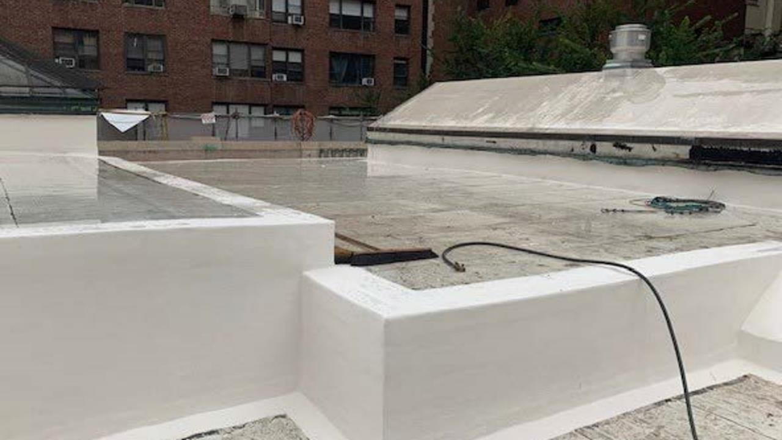
PROJECT MANAGEMENT & ADMINISTRATION
There are four ways cultural capital projects are managed:
1. DDC Managed (Design & Construction)
2. EDC Managed (Design & Construction)
3. Cultural Capital Grant (CCG): DDC
4. EDC Funding Agreement (FA)
Based on a project’s needs, and organization’s capacity, DCLA identifies an (the) appropriate managing Agency.
Morgan McKim Library Roof project

Slide 26
INITIATING THE PROJECT
Step 1
Step 2
Step 3
DCLA, a representative from the proposed managing agency, and cultural organization establishes:
Public purpose
Capital eligibility
Project complexity
Organization capacity
City requirements
Project budget
DCLA and the
cultural organization
finalize the Program:
The Program:
DCLA template prepared by the organization that
describes the scope of the project, overall development plan and a project funding
DCLA initiates the project by sending the
Program and supporting documents to the appropriate
managing agency:
DDC
EDC

Slide 27
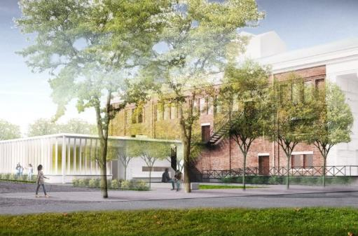
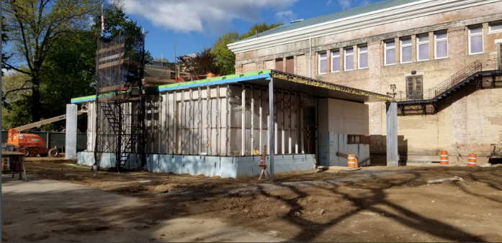
DDC MANAGED: CRITERIA 1
Generally, smaller cultural organizations that do not have the financial and operational resources and in-house experience to fund and manage capital projects in compliance with all City regulations benefit from DDC’s project management and design resources
Ideal for projects with limited private funding, where City funds must pay for design, or where city funds may be spread over multiple fiscal years
Design and construction phases are managed (DDC does not manage design only)
  Rendering and Construction Progress for Snug Harbor Music Hall Dressing Rooms

Slide 28
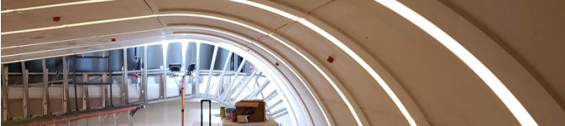
DDC MANAGED: CRITERIA 2
  BCM Auditorium
DDC administers the project and its funding:
Procurement of consultants and contractors
Management of contracts for design and construction
Review of design
Regulatory approval review
Construction progress
Budget management and oversight
Compliance and payment administration
Project Team: Cultural organization, DCLA, DDC and consultants
DDC Managed projects use both in-house resources
and private consultants and contractors

Slide 29
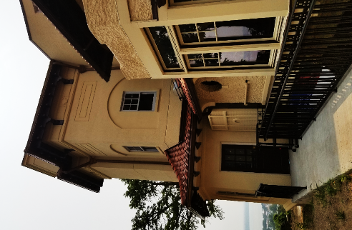
DDC MANAGED: DESIGN PROCESS 1
DDC can contract for design in three ways:
Project Excellence
A quality-based selection for procurement of design services.
Allows the City to hire firms based on their qualifications and past work, rather than on the more traditional lowest bid methodology.
Selection and Award takes about 3 months.
Design Schedule varies from 9 months – 2 years depending on the size of the project.
Visit the DDC website for the current list of Project Excellence Consultants.
Request for Proposal (RFP)
A custom RFP and contract is written for projects that require special expertise.
Firm is chosen based on specific project needs and process typically exceeds 9 months.
Design Schedule varies greatly depending on project size, but it is recorded in the contract with the architect.
Casa Belvedere

Slide 30
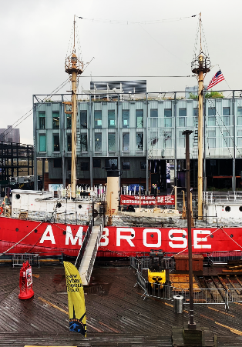
DDC MANAGED: DESIGN PROCESS 2
DDC can contract for design in three ways:
Requirements Contract
Specialized firms in mechanical, electrical, engineering, exterior, landmark and landscaping that are on retainer contract with DDC.
Selection takes 4–6 months.
Design Schedule takes 6-12 months.
  New DDC Pilot Initiatives
  In-House Design Pilot Program
  Design/Build
Ambrose at South Street Seaport Museum

Slide 31
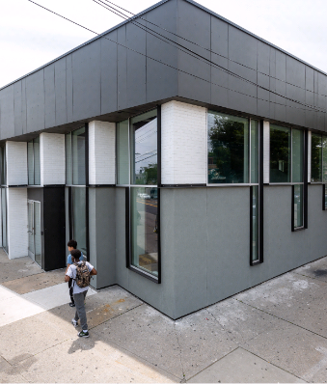
DDC MANAGED: CONSTRUCTION PROCESS
DDC can contract for construction in two ways:
Public Bid
The DDC openly and competitively bids the project, awarding to the lowest bidder
Selection Time: 5-6 months
Construction Schedule varies, typically 2-3 years
DDC manages project in-house or supplements management with a construction manager
JOCS (Job Order Contracting System)
On-call, requirement contracts that are best used for small, simple projects
Construction Schedule varies, but typically shorter because of small size of projects (1-2 years)
Bronx Council on the Arts

Slide 32
DDC MANAGED: GETTING STARTED
Updates to the Initiation Process:
There is a new initiation process for all DDC managed projects. DCLA project managers are now required to fill out forms through a Sponsor Agency Portal (SAP). This information relies heavily on the information you provide in the Program document.
The Program document will look a little different this year to reflect additional questions from DDC.
Please note: the sooner you get your Programs in, the better! Projects initiated early in the fiscal year have a better chance of getting through Front End Planning by February which means knowing potential shortfalls in time for the next funding request.
If your project is fully funded, please reach out to your DCLA project manager for a Program document – if we don’t get to you first!

Slide 33
DDC FRONT END PLANNING (FEP)
Front End Planning (FEP) is the first step for all DDC Managed projects. FEP performs an initial review of all project documents followed by a site visit, resulting in a report that will determine whether a project can move forward.
FEP team generally considers:
  Completeness, feasibility and complexity of submitted scope
  Budget
  Legal requirements
Report generally includes:
  Recommendations for changes to scope
  Cost estimate
  Project schedule
  Design Fee
FEP takes on average around three months to produce a report
Report findings will determine whether a project can proceed with design (i.e. DDC will return the project if the scope does not align with the budget)

Slide 34
DDC MANAGED: TIMELINE
In most cases, the City will manage your construction project. Average pre-COVID timelines were:
1 | Project Scope Creation
Work with DCLA Project Manager to define scope
3 | Project Design:
Consultants procurement and design is managed by DDC
5 | Construction:
DDC holds all contracts and manages construction through
C of O (if required)
3-9 Months
9
Months
12-18
Months
9
Months
6-24
Months
3
Mo
2 | Front End Planning:
DDC will do initial feasibility and cost estimate reports
4 | Construction Contract Bidding:
Once construction documents are finalized, project is bid out and contactors procured
6 | Project
Closeout:
Closeout with project
evaluation
and summary
OMB and Comptroller approval is required to engage a consultant. A Certificate to Proceed (CP) from OMB and a registered contract by the Comptroller will be needed at multiple steps.
Timeframes depend on the scale, budget and complexity of the project. This timeline represents optimal durations without delays and is based on complete submissions + timely actions. Compiling and approving legal requirements may result in delays (Restrictive Covenants, mortgage subordinations, lease amendments, etc.)

Slide 35
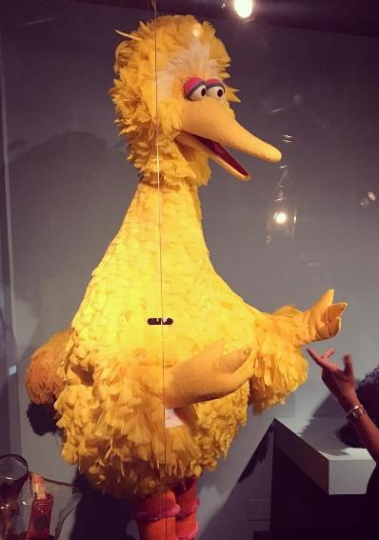
EDC MANAGED
EDC determines which projects they will manage
Projects must include an economic development focus (e.g. located within a redevelopment area and/or opportunity for job creation)
Project is technically complex and/or has special scheduling needs
Generally smaller cultural organizations that do not have the financial and operational resources to manage capital projects benefit from EDC’s project management resources
Ideal for projects with limited private funding or where the organization pays for design
Design is procured through a Request for Proposal (RFP); construction is managed by a pre-selected Construction Manager and a shortlist of contractors
Typically applies only to organizations on City-owned property
Henson Gallery at Museum of the Moving Image

Slide 36
EDC MANAGED: TIMELINE
In most cases, the City will manage your construction project. Average pre-COVID timelines were:
1 | Project Scope Creation
Work with DCLA and EDC to define scope
3 | Project Design:
Design is managed by EDC; CM is usually brought onboard
5 | Construction:
Contracts are held with EDC and managed with a CM
3
Mo
4-6
Months
6-15
Months
9
Months
6-24
Months
3
Mo
2 | Design Procurement:
EDC will manage an RFP process to procure a consultant
4 | Construction Contract:
Procurement through CM; contracts held by EDC
6 | Project Closeout:
Closeout with project evaluation and summary
A Certificate to Proceed (CP) from OMB and a registered contract by the Comptroller will be needed at multiple steps.
Timeframes depend on the scale, budget and complexity of the project. This timeline represents optimal durations without delays and is based on complete submissions + timely actions. Compiling and approving legal requirements may result in delays (Restrictive Covenants, mortgage subordinations, lease amendments, etc.)

Slide 37
COMMUNICATION FLOW CHART
For City managed projects, it is very important to follow a clear line of communication:
Design Consultant
Sub-Consultants
Cultural
Organization
Managing Agency:
DDC or EDC
DCLA
Contractors
Sub-Contractors

Slide 38
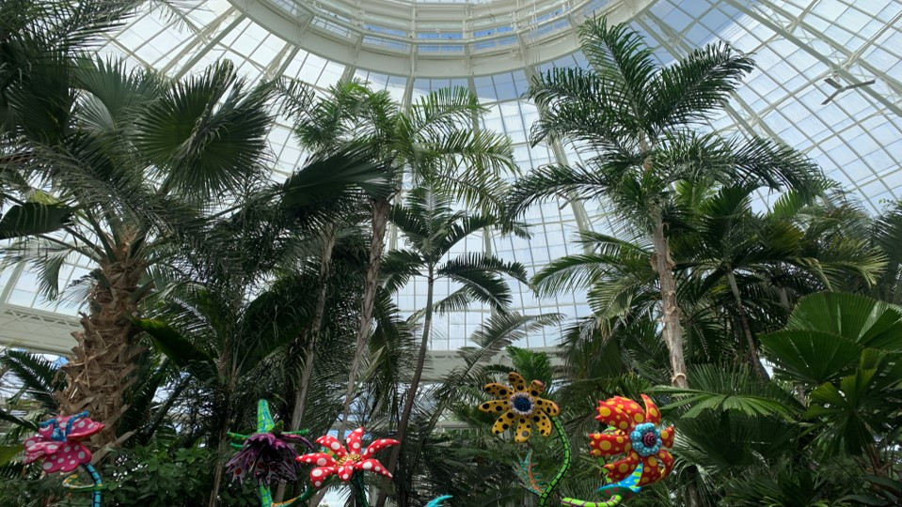
CCG: DDC CULTURAL CAPITAL GRANT
A Cultural Capital Grant allows a cultural organization to manage its own project while protecting the
City’s investment of public dollars. A CCG:
Guarantees scope at a fixed price
Allows capital funds to be reimbursed to the organization; cost overruns are borne by the organization
Requires robust public-private funding partnerships
Requires organization to have dedicated staff with construction experience to manage the project through to end of contract
Organization is responsible for compliance with all laws, policies and regulations associated with City funding
~2% City Administration Fee
Recently completed NYGB Greenhouse. Shown with Kusama exhibit.

Slide 39
CCG: DCLA REVIEW FOR ELIGIBILITY
The following is a sample of requirements to establish organizational capacity to manage a project:
Project Planning
Clear rationale for the project
Comprehensive, recent master plan or strategic plan; project is technically complex and has special scheduling needs
Project types include major renovation and construction
Familiarity with Compliance Paperwork (PassPort, Insurance, RC etc.)
Project Managerial
Capacity
Relevant in-house project management experience, including staff with construction experience
Addresses future maintenance/operation changes
Familiarity with approvals (ULURP, LPC, PDC etc.)
Organization
Managerial Capacity
Successful execution of mission
An actively engaged Board
Effective leadership/administration staff
Financial Capacity
Project requires significant private contribution, typically 50%
City funding is at least $1 million in current fiscal year
Capacity to fully finance project / cover all cost overruns
Capital campaign/plan with realistic goals
Institutional track record of successful fundraising campaigns

Slide 40
CCG: TIMELINE
Some organizations will manage their own design and construction through a Cultural Capital Grant (CCG) managed by DDC. Average pre-COVID timelines were:
2 | Greenlight Meeting:
Application to DDC and OMB for technical compliance review
4 | OMB Review:
OMB reviews scope for eligibility before issuing a Certificate to Proceed (CP)
6 | Certificate to Proceed:
OMB issues a CP
8 | Compliance Paperwork:
Additional paperwork before requisition
3 – 9 Months
Months
3
Months
1-3
Months
4
Months
1
Mo
1-2
Mo
Dependent on Project
1 | Scope Development:
Work with DCLA project manager to define scope and prepare CCG application
3 | CCG Package Preparation:
Work with DDC to prepare the CCG package
5 | Legal Documents:
Finalization of:
legal agreement(s), restrictive covenant, and compliance paperwork
7 | Comptroller:
Comptroller reviews CP before funds register
9 | Requisitions:
With funds registered, organization can request reimbursement for construction costs
Timeframes depend on the scale, budget and complexity of the project. The timeline shown represents optimal durations without delays and is based on complete submissions + timely actions.
Compiling and approving legal requirements may result in delays (Restrictive Covenants, mortgage subordinations,
lease amendments, etc.)

Slide 41
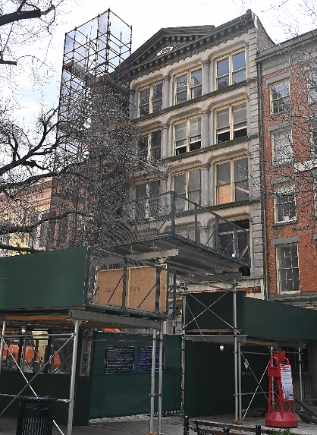
EDC FUNDING AGREEMENT
If City funding is allocated through a contract between EDC and a cultural organization, the following conditions apply:
Project has an economic development focus
Organization has the capacity to implement and maintain its capital project
Project is technically complex and has special scheduling needs
Organization is responsible for any cost overruns
Specific requirements, approvals and the Funding Agreement (FA) process must be complete in order to receive funds
2.5% fee with cap at 100k
Project requires significant private contribution
City funding is at least $500K and a private match is required
South Street Seaport Museum Thompson Warehouse

Slide 42
EDC FUNDING AGREEMENT: TIMELINE
A small number of organizations will manage their own design and construction through a Funding Agreement (FA) managed by EDC. Average pre-COVID timelines were:
1 | Define Scope and Budget/ FA Intake:
Work with DCLA and EDC to define scope and budget
3 | Procurement:
EDC reviews contractor procurement and compliance
5 | OMB Review:
OMB reviews scope for eligibility before issuing a Certificate to Proceed (CP)
7 | Record RC:
Restrictive Covenant (for non City owned property) is recorded with City
1-2
Months
4-8
Months
1-2
Mo
4
Months
1-3
Months
1
Mo
1
Mo
Dependent on Project
2 | Prepare Funding Agreement:
EDC will manage FA process including internal review, coordination with Law Dept. for FA and RC draft and OMB CP review
4 | Execute Funding Agreement:
EDC manages this phase internally
6 | Comptroller Registration:
Comptroller registers contract
9 | Requisitions:
With funds registered, organization can request reimbursement for construction costs
Timeframes depend on the scale, budget and complexity of the project. The timeline shown represents optimal durations without delays and is based on complete submissions + timely actions.
Compiling and approving legal requirements may result in delays (Restrictive Covenants, mortgage subordinations,
lease amendments, etc.)

Slide 43
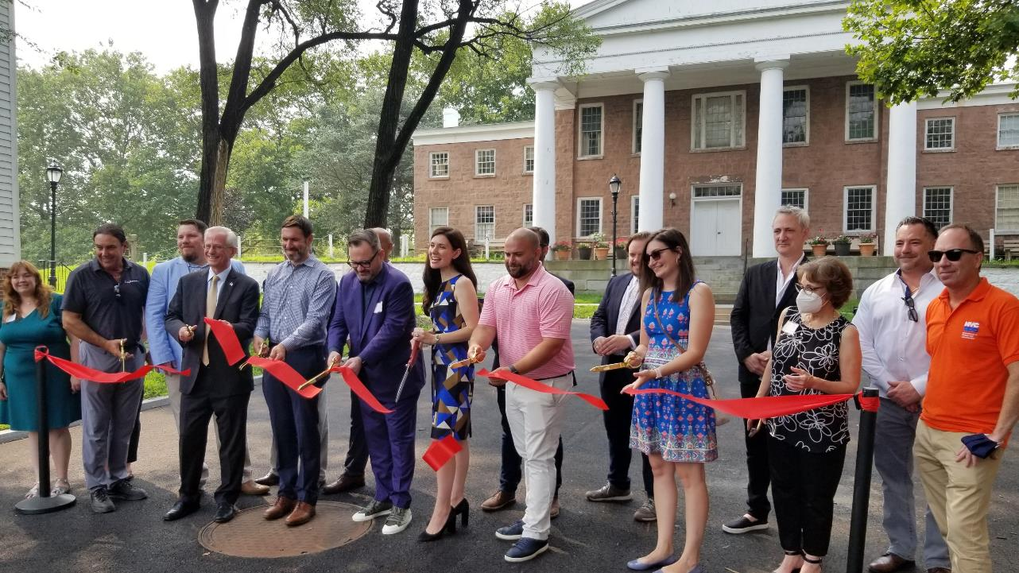
RIBBON CUTTING
Ribbon Cutting at Historic Richmond Town

Slide 44
We’re Here to Help
Andrew Burmeister
Assistant Commissioner
aburmeister@culture.nyc.gov
Angela Blocker
Director
ablocker@culture.nyc.gov
Victor Metoyer
Deputy Director
vmetoyer@culture.nyc.gov
Sara Minard
Director of Special Projects
sminard@culture.nyc.gov
David Bryant
Capital Project Manager
dbryant@culture.nyc.gov
Stephanie Kingpetcharat
Capital Project Manager
skingpetcharat@culture.nyc.gov
Darren Brannon
Capital Equipment Manager
dbrannon@culture.nyc.gov
Kevin Maloof
Capital Equipment Manager
kmaloof@culture.nyc.gov
Carolyn Sarkis
Capital Budget Analyst
csarkis@culture.nyc.gov
Questions? Talk to us!
www.nyc.gov/culture

Slide 45
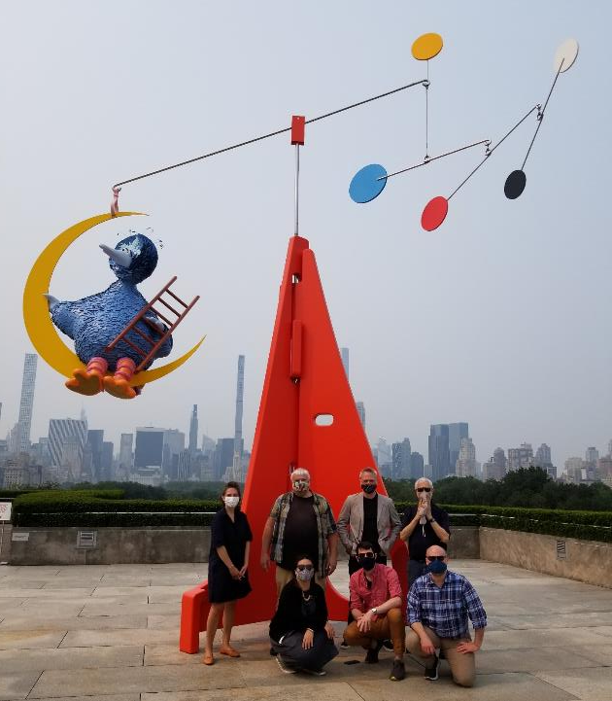
APPENDIX
Capital Unit Team on Roof of Met Museum

Slide 46
Useful Links
Green Building Laws: https://www1.nyc.gov/site/oec/green-building/green-building-laws-regulations.page
    DCAS ACE/ExCEL: https://www1.nyc.gov/site/dcas/agencies/competitive-funding-programs.page
Con Edison Energy Efficiency Rebates: https://www.coned.com/en/save-money/rebates-incentives-tax-credits/rebates-incentives-tax-credits-for-commercial-industrial-buildings-customers
NYSERDA New Construction/Renovation Energy Rebates: https://www.nyserda.ny.gov/All-Programs/Programs/New-Construction-Program
Directive 10: https://comptroller.nyc.gov/services/for-city-agencies/comptrollers-directives-and-memoranda/directives-and-memoranda/

Slide 47
Q & A
You can submit questions in the following ways:
      Q + A feature on Zoom
      Through emails to: capitalrequest@culture.nyc.gov
When you submit a question through any of the above options, please let us know your name and what organization you are with.
We will do our best to answer as many questions as possible. If we run out of time and find there are still many questions to answer, we will try to provide answers in a follow up email to those on the RSVP list. You can also email questions after the event to capitalrequest@culture.nyc.gov.

